Slide 1
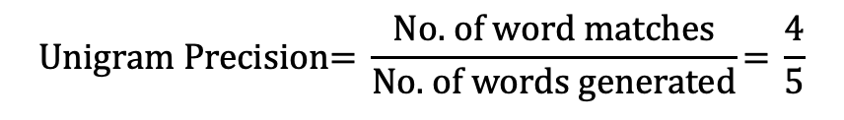
Bilingual Evaluation Understudy: BLEU [Translation]
Mainchine generated
I
am
happy
with
you
Human reference
I
really
happy
with
you
too
$$\text{Unigram} \text{Precision}\text{= }\frac{\text{No}\text{. }\text{of} \text{word} \text{matches}}{\text{No}\text{. }\text{of} \text{words} \text{generated}}\text{= }\frac{\text{4}}{\text{5}}$$

Slide 2
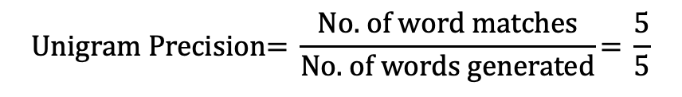
Bilingual Evaluation Understudy: BLEU [Translation]
Mainchine generated
happy
happy
happy
happy
happy
Human reference
I
really
happy
with
you
too
$$\text{Unigram} \text{Precision}\text{= }\frac{\text{No}\text{. }\text{of} \text{word} \text{matches}}{\text{No}\text{. }\text{of} \text{words} \text{generated}}\text{= }\frac{\text{5}}{\text{5}}$$

Slide 3
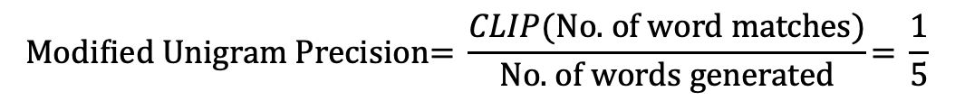
Bilingual Evaluation Understudy: BLEU [Translation]
Mainchine generated
happy
happy
happy
happy
happy
Human reference
I
really
happy
with
you
too
$$\text{Modified} \text{Unigram} \text{Precision}\text{= }\frac{CLIP(\text{No}\text{. }\text{of} \text{word} \text{matches})}{\text{No}\text{. }\text{of} \text{words} \text{generated}}\text{= }\frac{\text{1}}{\text{5}}$$

Slide 4
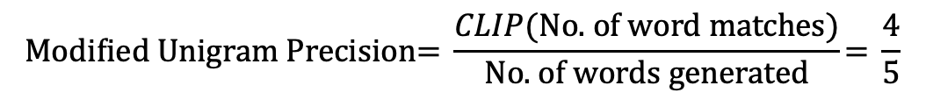
Bilingual Evaluation Understudy: BLEU [Translation]
Mainchine generated
I
happy
am
you
with
Human reference
I
really
happy
with
you
too
$$\text{Modified} \text{Unigram} \text{Precision}\text{= }\frac{CLIP(\text{No}\text{. }\text{of} \text{word} \text{matches})}{\text{No}\text{. }\text{of} \text{words} \text{generated}}\text{= }\frac{\text{4}}{\text{5}}$$

Slide 5
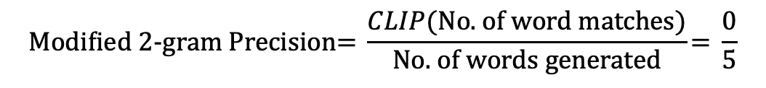
Bilingual Evaluation Understudy: BLEU [Translation]
Mainchine generated
I happy
happy am
am you
you with
Human reference
I really
really happy
happy with
with you
you too
$$\text{Modified}\text{ 2−}\text{gram} \text{Precision}\text{= }\frac{CLIP(\text{No}\text{. }\text{of} \text{word} \text{matches})}{\text{No}\text{. }\text{of} \text{words} \text{generated}}\text{= }\frac{\text{0}}{\text{5}}$$

Slide 6
Bilingual Evaluation Understudy: BLEU [Translation]
Mainchine generated
I happy
happy am
am you
you with
Human reference
I really
really happy
happy with
with you
you too
$$\text{Modified}\text{ 2−}\text{gram} \text{Precision}\text{= }\frac{CLIP(\text{No}\text{. }\text{of} \text{word} \text{matches})}{\text{No}\text{. }\text{of} \text{words} \text{generated}}\text{= }\frac{\text{0}}{\text{5}}$$

Slide 7
Bilingual Evaluation Understudy: BLEU [Translation]
Fast and easy to calculate
Widely used
Doesn’t consider meaning
Doesn’t incorporate sentence structure
Struggle with non-English language
Hard to compare score with different tokenizers

Slide 8
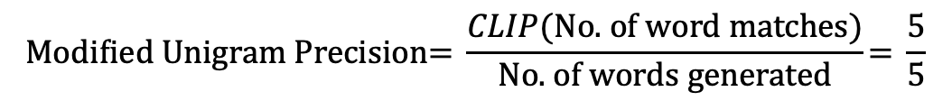
Metric of Evaluation of Machine Translation with Explicit Ordering: METEOR [Translation]
Mainchine generated
I
am
happy
with
you
Human reference
I
really
happy
with
you
too
$$\text{Modified} \text{Unigram} \text{Precision}\text{= }\frac{CLIP(\text{No}\text{. }\text{of} \text{word} \text{matches})}{\text{No}\text{. }\text{of} \text{words} \text{generated}}\text{= }\frac{\text{5}}{\text{5}}$$

Slide 9
Metric of Evaluation of Machine Translation with Explicit Ordering: METEOR [Translation]
Mainchine generated
I
happy
am
you
with
Human reference
I
really
happy
with
you
too
$$\text{Modified} \text{Unigram} \text{Precision}\text{= }\frac{CLIP(\text{No}\text{. }\text{of} \text{word} \text{matches})}{\text{No}\text{. }\text{of} \text{words} \text{generated}}\text{= }\frac{\text{1}}{\text{5}}$$

Slide 10
Metric of Evaluation of Machine Translation with Explicit Ordering: METEOR [Translation]
Using synonym (WordNet)
Widely used
Consider order of word
Struggle with non-English language
Hard to compare score with different tokenizers
Complex to calculate

Slide 11

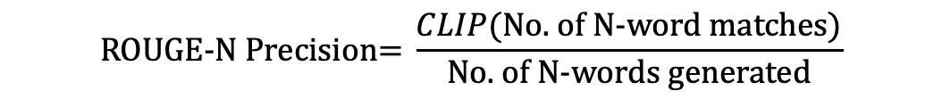

Recall-Oriented Understudy for Gisting Evaluation: ROUGE [Summarization]
$$\text{ROUGE}\text{-}\text{N} \text{Precision}\text{= }\frac{CLIP(\text{No}\text{. }\text{of} \text{N}\text{-}\text{word} \text{matches})}{\text{No}\text{. }\text{of} \text{N}\text{-}\text{words} \text{generated}}$$
$\text{ROUGE}\text{-}\text{N} \text{Recall}\text{= }\frac{CLIP(\text{No}\text{. }\text{of} \text{N}\text{-}\text{word} \text{matches})}{\text{No}\text{. }\text{of} \text{N}\text{-}\text{words} \text{reference}}$x
Generated: “ The quick brown fox jumps over the lazy dog.”
Reference: “ The quick brown dog jumps over the lazy fox.”
Longest Common Subsequence (LCS): “The quick brown jumps over the lazy” – 7 words
$$\text{ROUGE}\text{-}\text{L}\text{= }\frac{CLIP(\text{No}\text{. }\text{of} \text{LCS} \text{matches})}{\text{No}\text{. }\text{of} \text{N}\text{-}\text{words} \text{generated}}$$

Slide 12
Recall-Oriented Understudy for Gisting Evaluation: ROUGE [Summarization]
Fast and easy to use
Automatic evaluation to scale
Quantitative measurement
Limited contextual understanding in surface
Reference dependence

Slide 13
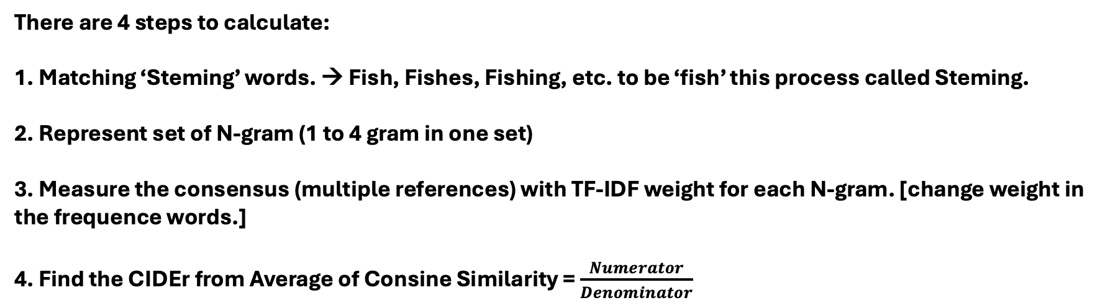
Consensus-based Image Description Evaluation: CIDEr [Generated]
There are 4 steps to calculate:
1. Matching ‘Steming’ words. → Fish, Fishes, Fishing, etc. to be ‘fish’ this process called Steming.
2. Represent set of N-gram (1 to 4 gram in one set)
3. Measure the consensus (multiple references) with TF-IDF weight for each N-gram. [change weight in the frequence words.]
4. Find the CIDEr from Average of Consine Similarity = $\frac{Numerator}{Denominator}$

Slide 14
Consensus-based Image Description Evaluation: CIDEr [Generated]
See more than matching words
Focus on context
Hard to compute
Need more than one reference

Slide 15
Summary
BLEU focuses on n-gram precision with brevity penalty.
ROUGE emphasizes recall and overlap between generated and reference texts.
METEOR balances precision and recall with synonyms and fragmentation penalties.
CIDEr uses TF-IDF weighting to emphasize the importance of n-grams and calculates similarity as a weighted average over n-grams, considering consensus among multiple references.

Slide 16
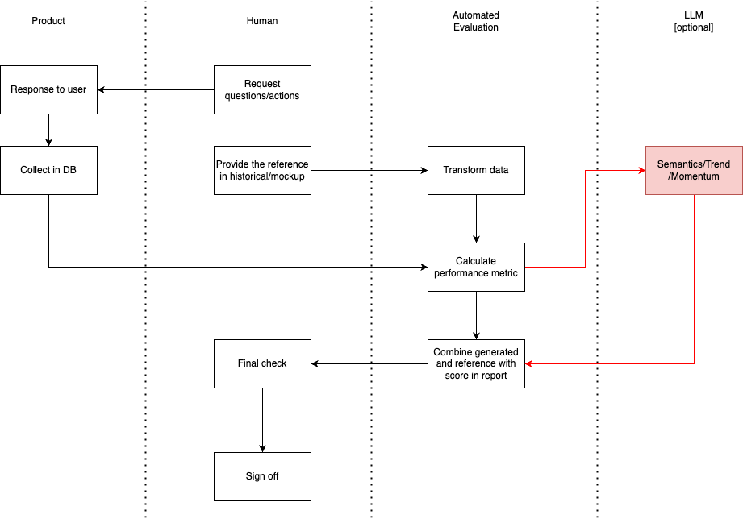
Operation Flow

Slide 17
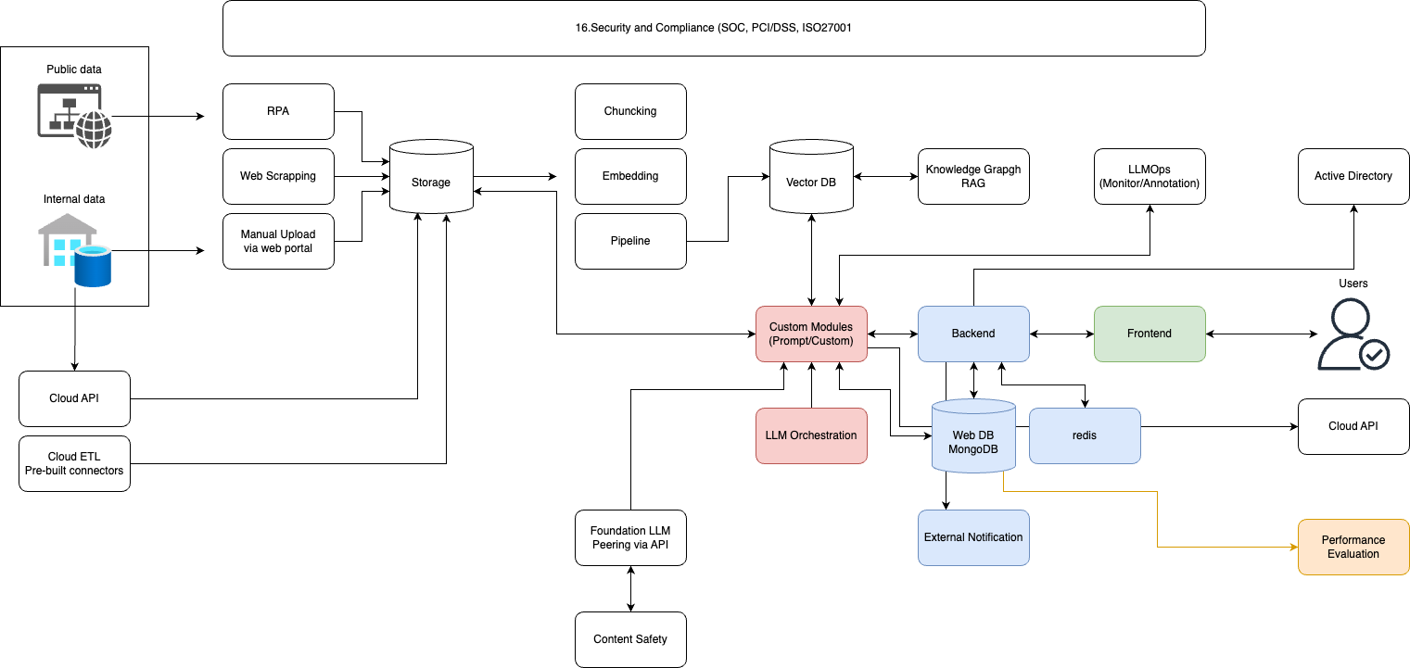
Product Overview

